Slide 1


Disaster Recovery Advisor
Haldia Institute of Technology
Student Details
Roll Number

Slide 2
Introduction
This project aims to develop an AI/ML-based system that predicts the type and duration of natural disasters while providing tailored recovery recommendations.

Slide 3
Understanding Disasters
Natural disasters include floods, earthquakes, and storms, each with unique characteristics. The project analyzes past data, weather patterns, and geographical features to predict these disasters.

Slide 4
Challenges in Disaster Response
01
02
03
Challenges in Resource Distribution
Understanding Disasters
Better Preparation
Governments, NGOs, and local authorities often struggle to distribute resources effectively, leading to delays and inefficient disaster response.
Without a central system that collects and analyzes data, it becomes difficult to prepare for disasters and reduce their impact on people and buildings.
Using past data, weather patterns, and location details to predict the type and duration of disasters like floods, earthquakes, storms, etc.

Slide 5
Purpose of the Project
Enhancing Disaster Preparedness
Efficient Resource Allocation
Develops a system that leverages AI/ML to predict natural disasters
Provide governments, NGOs, and local organizations with actionable insights for better planning and distribution of resources during disasters.
Reducing Disaster Impact
Improved Recovery Strategies
Use technology to minimize the damage disasters cause to people and communities..
Suggest tailored recovery steps based on the specific disaster type, ensuring a faster and more efficient recovery process for affected regions.

Slide 6

What it does?
Provides Recovery Plans
Learning from Past Disasters
Helps with Planning
Analyze past data to improve disaster preparedness and recovery in the future.
Act as a support tool for better long-term disaster planning and resource management.
Suggest specific recovery steps based on the type and severity of the disaster to help affected areas recover faster.

Slide 7
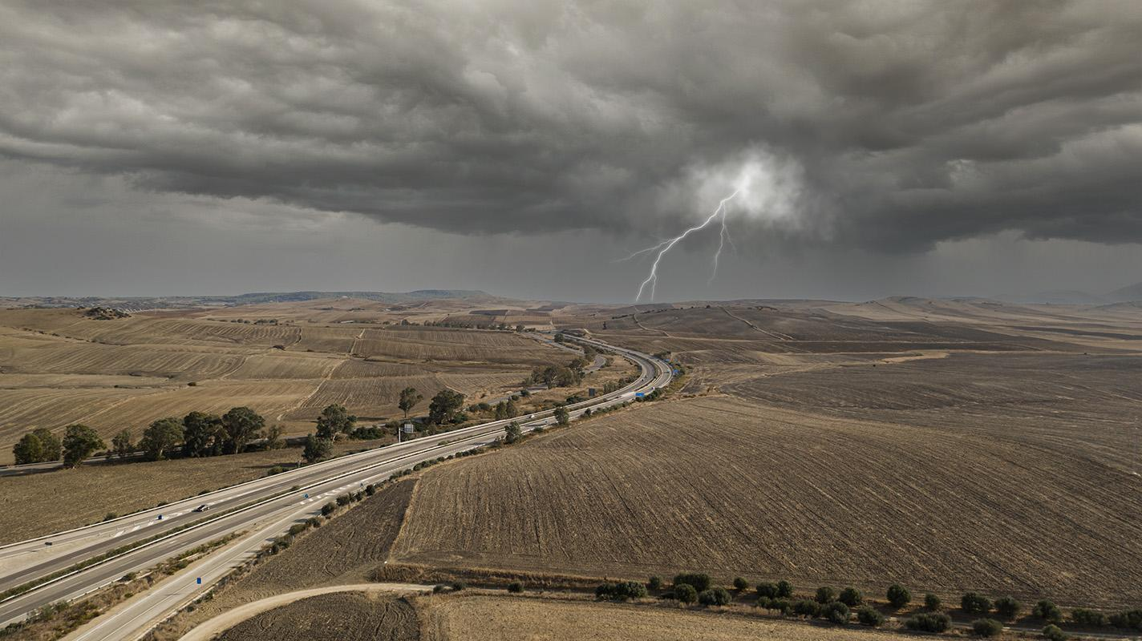
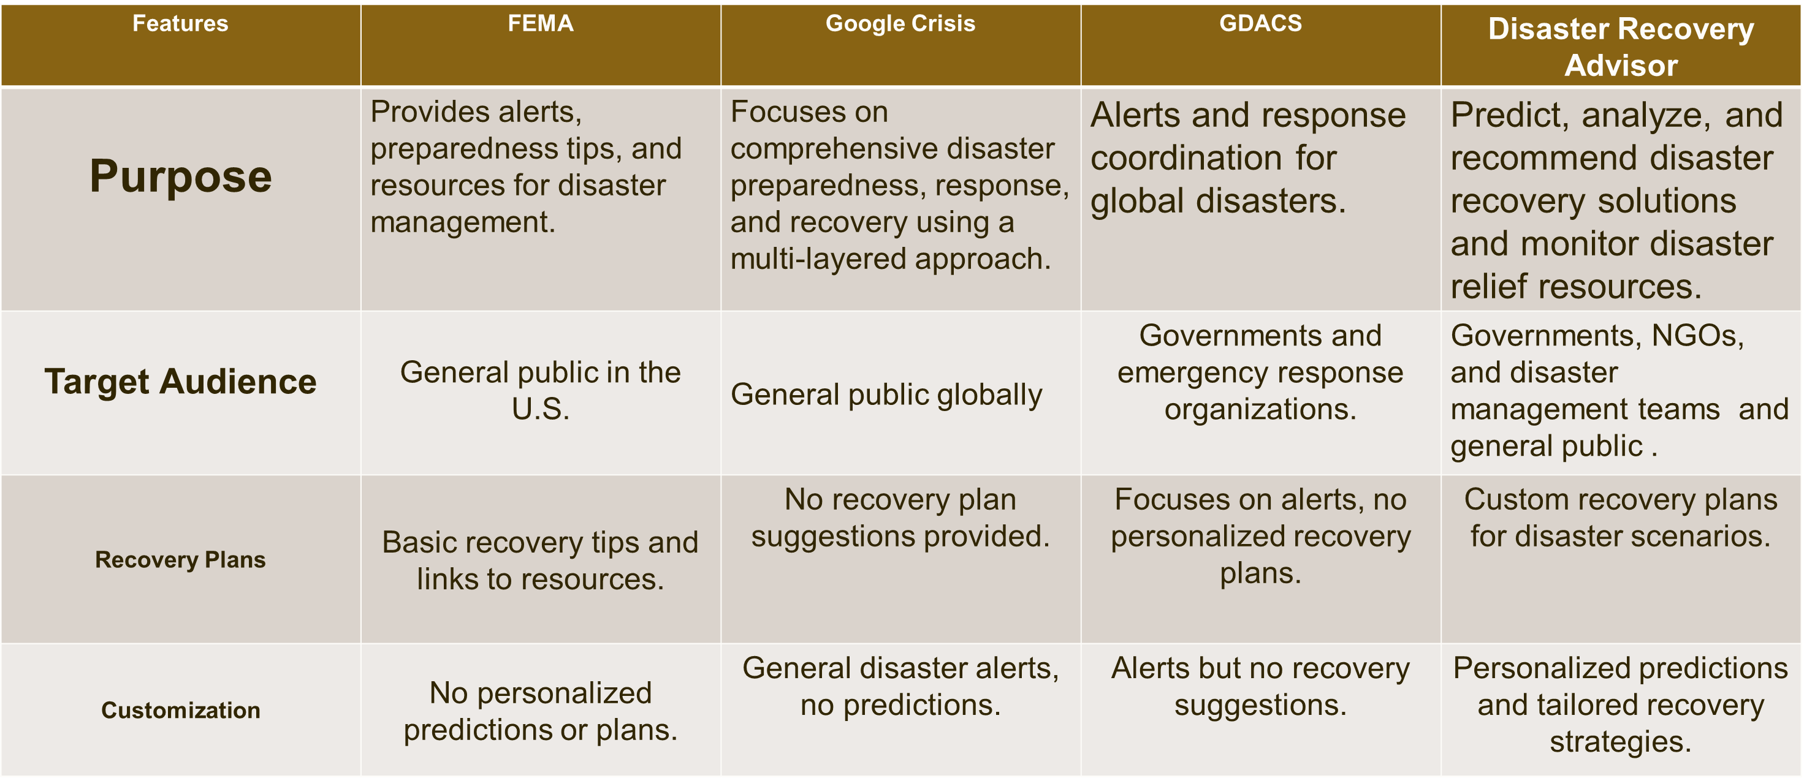
Individuality

Slide 8
Application in the Real World
Government Agencies | Plan resource allocation and evacuation strategies.
NGOs | Prioritize aid distribution
Communities | Educate and prepare for potential disasters.
Insurance Companies | Assess risks and tailor policies
Climate Researchers | Analyze patterns and improve forecasts.
Urban Planning | Infrastructure planning based on disaster patterns.

Slide 9

Algorithm Used?
Machine Learning Model
Random Forest Algorithm
Random Forest is a machine learning algorithm that uses many decision trees to make better predictions. Each tree looks at different random parts of the data and their results are combined by voting for classification or averaging for regression. This helps in improving accuracy and reducing errors.

Slide 10
WHY ? Random Forest
1. High Accuracy
Provides reliable and precise predictions.
Why: Combines the output of multiple decision trees, reducing individual errors.
2.Handles Missing Values
Benefit: Robust to incomplete or missing data.
Why: Trees can still split and vote even if some features are missing.
3. Works with Large Datasets
4. Reduces Overfitting
Efficiently handles high-dimensional or large-scale data.
Why: Parallel tree construction allows scalability and fast computation.
Better generalization to unseen data.
Why: Random feature selection and bootstrapped samples increase diversity and reduce variance.

Slide 11
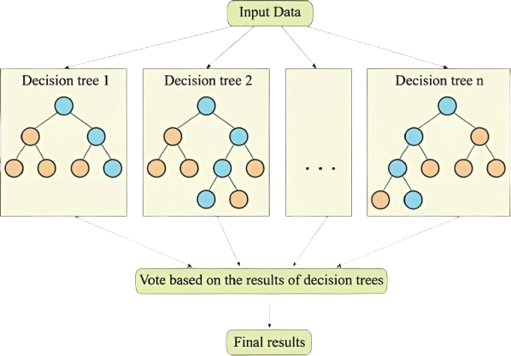
Dataset is split into - 80% for training 20% for testing

Slide 12
Accuracy: 0.953822134150003
Random Forest clearly outperforms all other models making it the best choice for this classification task.

Slide 13
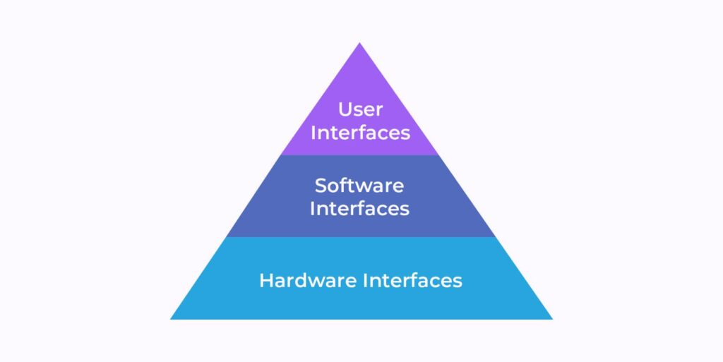
Tools & Technologies
Processor: Intel i5 or above
RAM: Minimum 8 GB
Storage: Minimum 256 GB SSD
Hardware Requirements
Software Requirements
Operating System: Windows/Linux
Development Tools: Jupyter Notebook, VS Code
Language: Python 3.12.0
Framework: Flask 3.1.0
Libraries: Pandas, NumPy, Scikit-learn, Matplotlib, Ollama (LLM)

Slide 14
Requirements Analysis
Data Pre-processing: Cleaning data involves removing unwanted information and retaining only the relevant features.
Login and Signup Module: The login and signup modules enable user authentication, ensuring personalized access to the platform. Upon successful login, users are directed to a tailored version of the website based on their profile.
ML Model Development for Prediction:
Build predictive models to determine disaster type, duration and impacts.

Slide 15
Requirements Analysis
Recommendation System for Recovery:
Provide tailored recovery suggestions based on the predicted disaster type.
Disaster Relief Assistance System :
Allows government bodies and NGOs to add and monitor their relief
materials. The system checks whether sufficient resources are available, if not, it prompts for additional provisioning to ensure effective disaster response and preparedness.
User-Friendly Interface for Visualization and Insights :
Design an accessible platform to present predictions, recommendations and relief assistance system.

Slide 16

Custom Recovery Plans Ollama
Ollama is a local, open-source AI model runner that lets users download and run large language models directly on their personal computers or servers.
1. Immediate Response (First 24 hours)
2. Short-Term Recovery (First 72 hours)
3. Medium-Term Actions (1 week - 1 month)
4. Long-Term Rehabilitation (1+ months)
5. Required Resources (Equipment, personnel, funding)
6. Safety Precautions (Risks to avoid)

Slide 17
Conclusion
The Disaster Recovery Advisor project uses AI/ML to improve disaster prediction, recovery planning, and resource management. With over 85% prediction accuracy, it provides practical tools like recovery plans, inventory tracking, and dashboards. Tested in simulations, it helps governments and communities respond better and build disaster resilience.

Slide 18
Future Enhancements
Collaboration Dashboard for NGOs/Govt
Create a shared dashboard for coordination between multiple NGOs and government bodies to avoid redundancy and improve efficiency.
Mobile App for Field Agents
Develop a lightweight mobile version for volunteers and government officials to update and access data from affected regions in real-time.
Multilingual Support
Add regional language support to ensure accessibility for local communities and volunteers.

Slide 19
THANK YOU

